Slide 1
Graphical Passwords Authentication using Style Transfer

Slide 2
Check the project here:
http://cnsproject.pythonanywhere.com/

Slide 3
Neural Style Transfer
Neural Style Transfer refers to a class of software algorithms that manipulate digital images, or videos, to adopt the appearance or visual style of another image. NST algorithms are characterized by their use of deep neural networks in order to perform the image transformation.

Slide 4
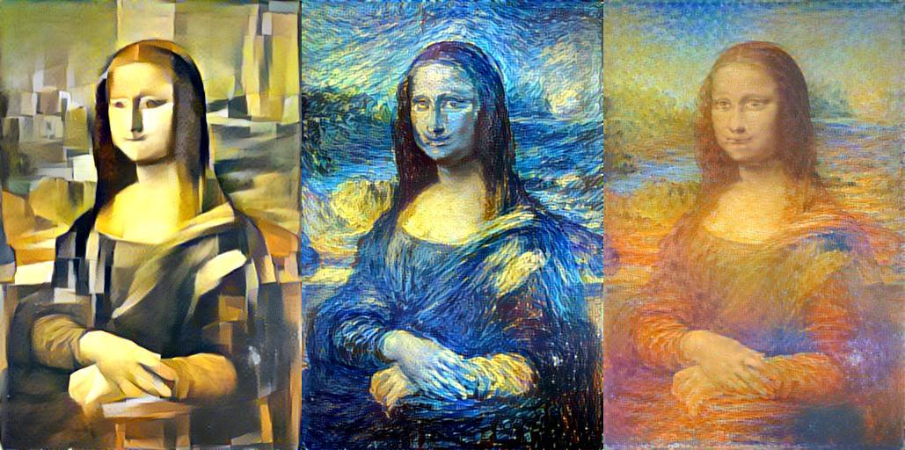

Slide 5
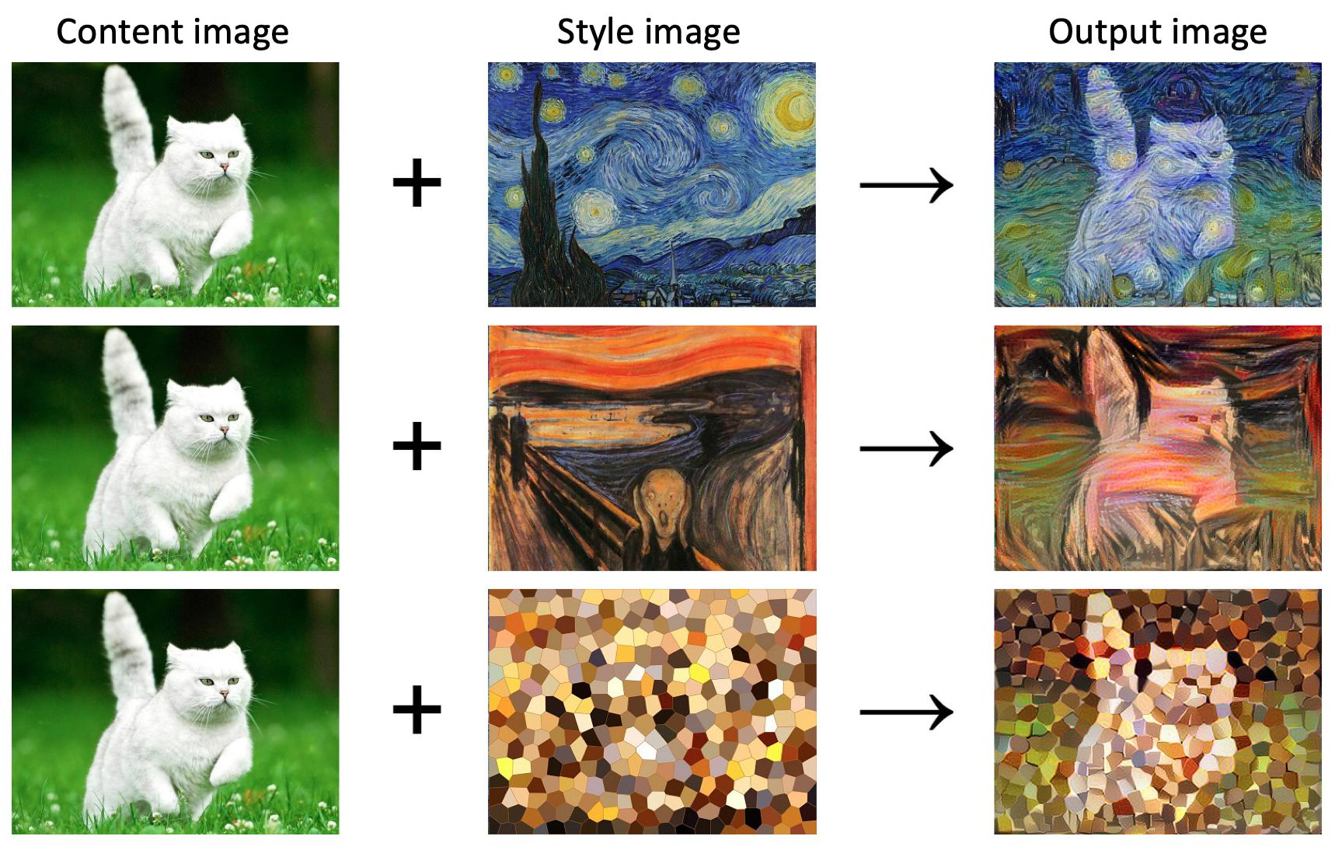

Slide 6
How NST used for Graphical Password Authentication?
Sign Up:
Firstly, the user chooses his username and uploads 3 images of his/her own choice.Then the user must select one of the styles provided by the authority.
Subsequently, the user will be shown the three images by applying the style,which the user need to remember.

Slide 7



Example:
Uploaded Images:

Slide 8
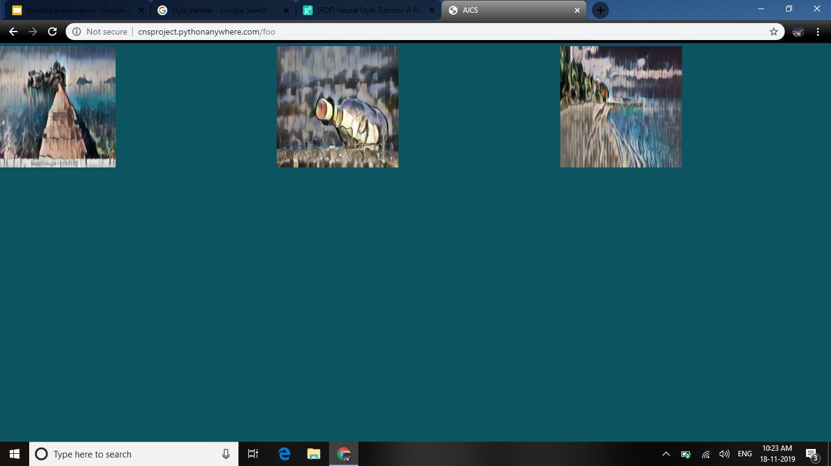
After Sign Up:

Slide 9
Login:
In this phase, the user needs to enter the username and login.Then a grid of 3x3 is displayed with the images of some random style.The user needs to select the identify the image the he/she uploaded.If this is successful then the page is redirected to another verification.
In the next step a grid of 5x5 is displayed from where the user needs to select the remaining two stylised images of his uploaded images.If he identifies the two images correctly then the login was successful or else not.

Slide 10
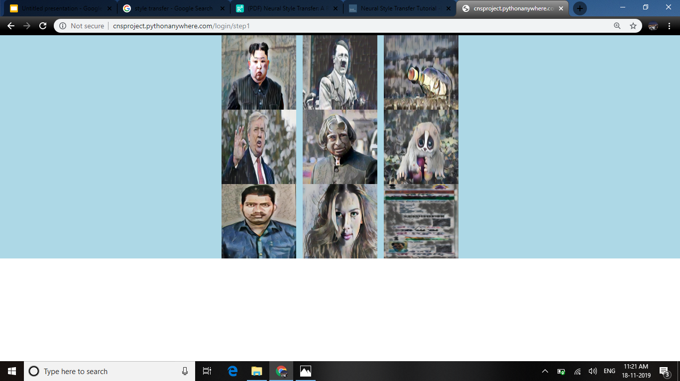
Step 1:

Slide 11
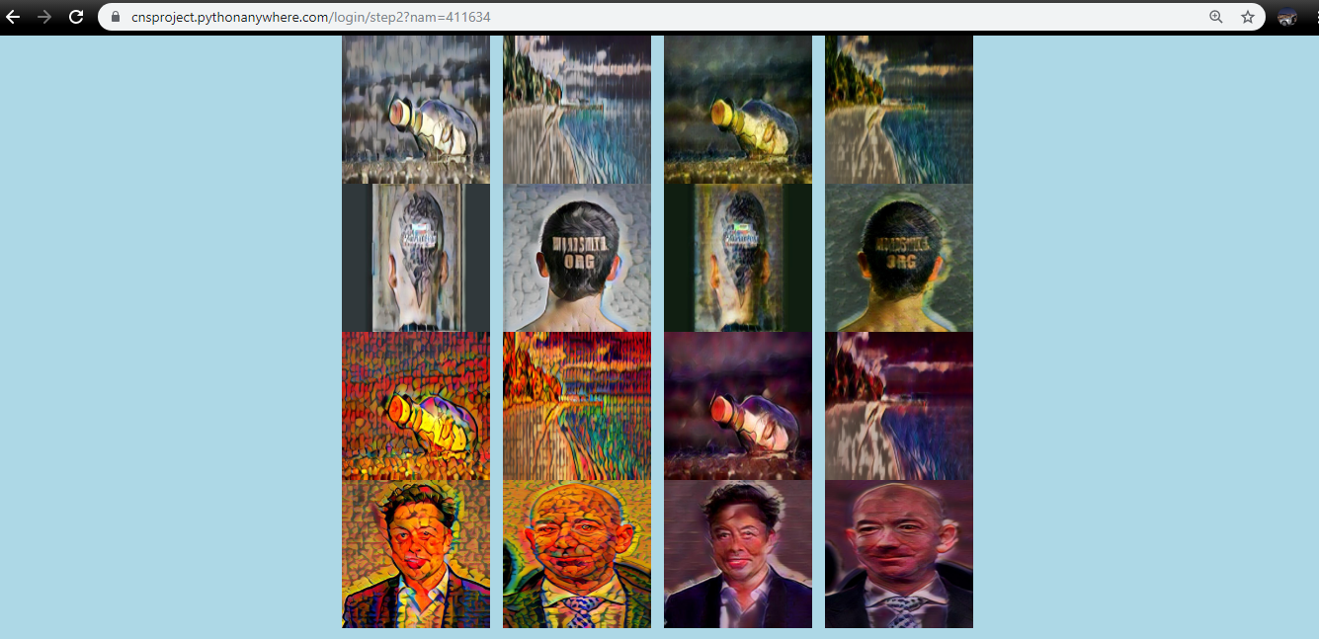
Step 2:

Slide 12
What our project satisfies:
It is safe from shoulder surfing attacks
It prevents Hidden Camera Attacks
No phishing attacks are possible
Guessing attacks are impossible because number of attempts to login are limited.

Slide 13
Thank You…

